Slide 1



Day 25
contact@anubhavtrainings.com
ABAP RESTFUL APPLICATION PROGRAMMING

Slide 2

Agenda – Day 25
Evolution of ABAP Programming Model
What is RAP (Restful Application Programming)
Flow of Restful Application Programming
Types of Scenarios
Managed Scenario
Unmanaged Scenario
Explanation of Flight Data Model
Flow of Development (Unmanaged Scenario)
Defining CDS Views
Creating OData Service ( Business Service)

Slide 3
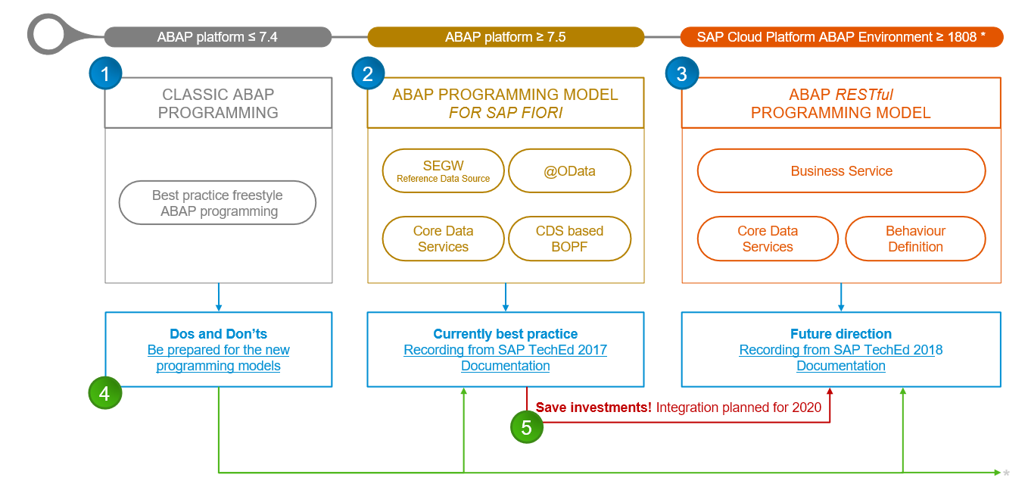
Evolution of ABAP Programming Model

Slide 4
Restful ABAP Programming
The ABAP RESTful programming model defines the architecture for efficient end-to-end development of intrinsically SAP HANA-optimized OData services (such as Fiori apps) in SAP Business Technology Platform ABAP Environment. It supports the development of all types of Fiori applications as well as A2X services. It is based on technologies and frameworks such as Core Data Services (CDS) for defining semantically rich data models and a service model infrastructure for creating OData services with bindings to an OData protocol and ABAP-based application services for custom logic and SAPUI5-based user interfaces .
The whole architecture is based on
CDS views – will helps you to create semantically rich data model.
Business Object here is a node inside a tree data structure which is achieved by using root keyword at CDS view level, this is needed only if we want to add transactional capability.
Finally create a service using service definition and service binding .
The binding will confirm the Purpose of service – API or Fiori.
UI layer with the Fiori app using elements.

Slide 5
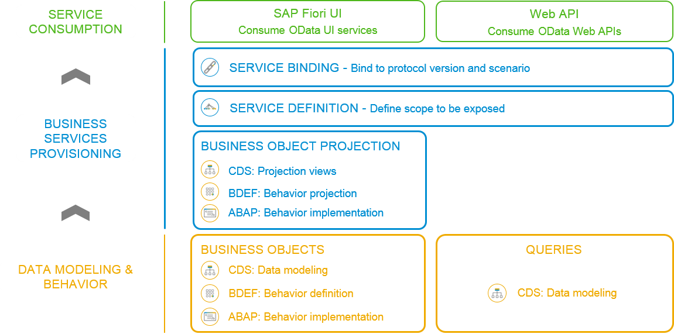
Flow of RESTful Application Programming

Slide 6
Types of Scenario
Brownfield Implementation
Is used when we want to create a transactional application which can insert, update, delete data from the system by writing your own logic
You already have Business logic with you and you want to use that business logic to perform transactional capability
You are own your own to manage your implementation.
02. Managed Scenario
Greenfield Implementation
Is used when we want to create a transactional application which can insert, update, delete data from the system by using the framework provided implementation
You do not have Business logic with you and you want system to create business logic for you automatically.
01. Un-Managed Scenario

Slide 7

BO runtime implementation types
INTERACTION
SAVE
Unmanaged
PHASE
SEQUENCE
For brownfield developments with available application code for
interaction phase, transactional buffer, and save sequence
finalize
➔
Developers in charge of BO runtime: CRUD operations
check_before_save
➔
Adapters needed to integrate the existing code
MODIFY
adjust_numbers
READ
LOCK
Managed
save
For greenfield developments with standard implementation
(
o
pt. unmanaged appl. components: DB tables, lock/PFCG object, update
task FM)
Transactional
➔
Standard CRUD operations work out of the box
buffer
Developers add BO
SAP HANA
➔
-
specific business logic
BUSINESS OBJECT RUNTIME

Slide 8
Flow of Development (Unmanaged Scenario)
Fiori UI
Service Binding for UI
Service Definition
Travel – Using /demo/travel
Projection view- what we want to show to UI
1
N
I_Currency
1
N
N
Agency
Customers
I_Country

Slide 9

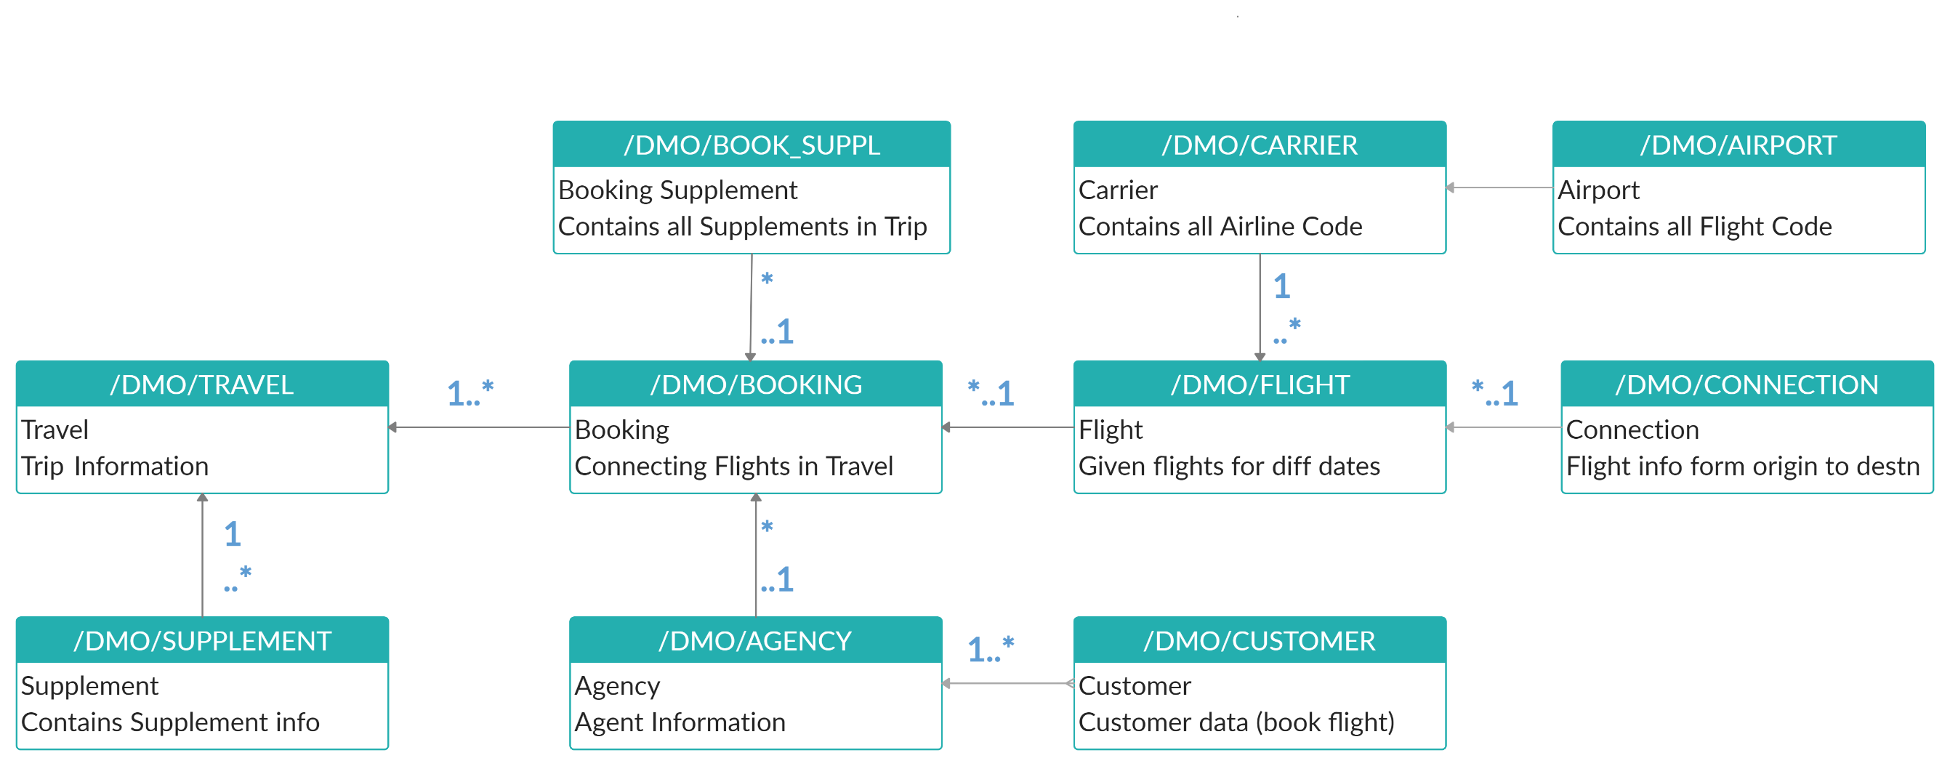
Explanation of Flight Data Model
If Data is not found in these Table’s please execute Data Generator Class “/dmo/cl_flight_data_generator”

Slide 10
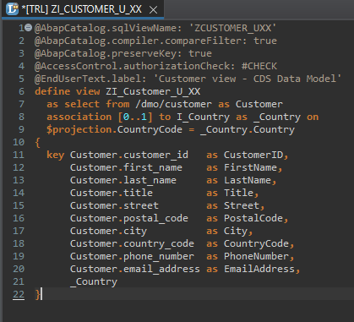
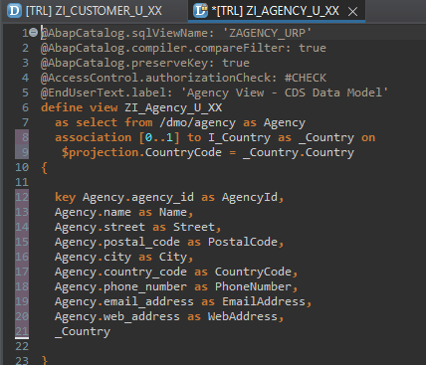
Defining Data Models
Defining Data Models
Create Customer CDS View “ZI_Customer_U_XX”
Create Agency CDS View “ZI_Agency_U_XX”

Slide 11
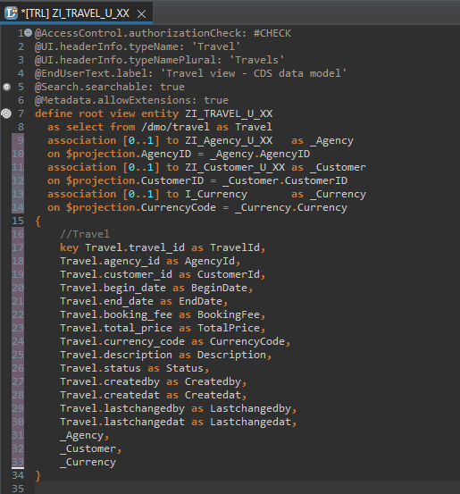
Root CDS Entity
Root CDS Entity
On top of Customer and Agency CDS View we Create Root CDS View Entity called “ZI_TRAVEL_U_XX”.
With Annotations like Metadata ,Search ,
Semantic Annotation etc.
Association to Agency ,Customer , Currency.

Slide 12
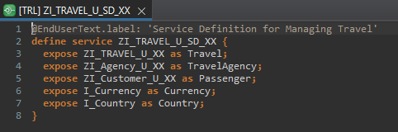
Create OData Service ( Business Service )
Create OData Service ( Business Service )
A business service definition (short form: service definition) describes which CDS entities of a data model are to be exposed so that a specific business service, for example, Sales Order handling, can be enabled. It is an ABAP Repository object that describes the consumer-specific but protocol-agnostic perspective on a data model. “ZI_TRAVEL_U_SD_XX”
CDS Entity
Service Definition
Service Binding

Slide 13
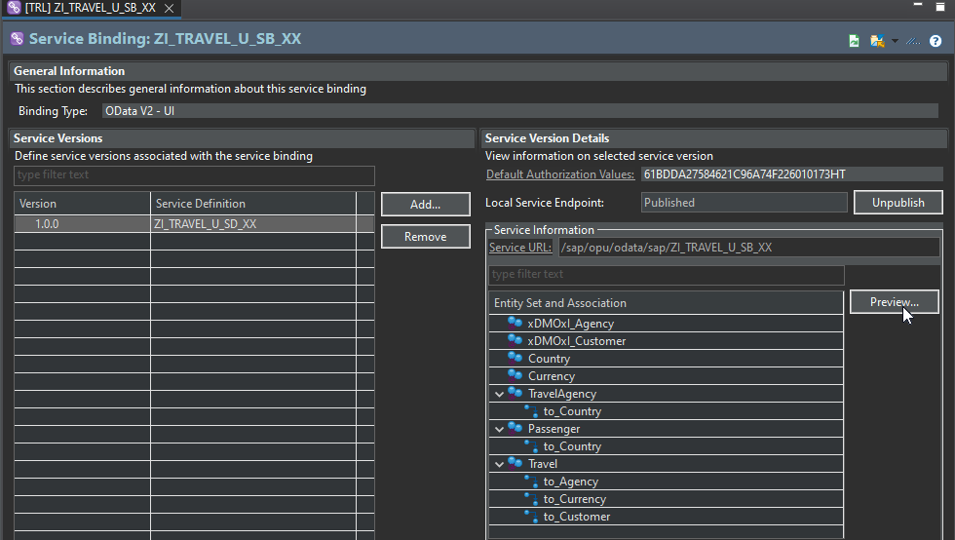
Service Binding ( Business Service )
Service Binding ( Business Service )
The business service binding (short form: service binding) is an ABAP Repository object used to bind a service definition to a client-server communication protocol such as OData. Like any other repository object, the service binding uses the proven infrastructure of the ABAP Workbench, including the transport functionality.
The business service binding (short form: service binding) is an ABAP Repository object used to bind a service definition to a client-server communication protocol such as OData. Like any other repository object, the service binding uses the proven infrastructure of the ABAP Workbench, including the transport functionality.

Slide 14

End of Day 25
Trainer: Anubhav Oberoy

Slide 15
Trainer: Anubhav Oberoy

Slide 16
THANK YOU
If you cannot do
great things, do small things in a great way.
Anubhav Oberoy
https://www.anubhavtrainings.com

Slide 17


We’re committed to empower you to be
Most Desirable Resource
through powerful training solutions.
We build the workforce of the future.
250+
Corporate Clients
30,000+
Learners Trained
25000+
Learners Placed
FREE WEBINARS
Sign up for free webinars with industry experts every fortnight!
Enroll Now!
Contact us today!
https://anubhavtrainings.com/

Slide 18




More from AnubhavTrainings.com

